Slide 1

Network Analysis of Shanghai covid-19 Lockdown
Presenter: Kunlun Zhu
Advisor: Prof.Munther Dahleh
TexPoint fonts used in EMF.
Read the TexPoint manual before you delete this box.: AAAAAAAAAAAA

Slide 2



Background & Problem Definition
Background
  From March 12th to June 1th,Shanghai has
  been carrying out a lock down policy to reduce
  the Covid-19 affection.
  It cause huge effect on people’s daily life as
  well as the global supply chain and economics.
Problem Definition
  Basic Network Analysis of the Covid-19 affection network(etc, connectivity, power law, tipping point)
  How effective is the lock down policy for preventing the Covid-19 affection?
  The comparation between the Chinese zero-covid policy and western covid-19 policy
Notes:
Picture is searched from the internet

Slide 3
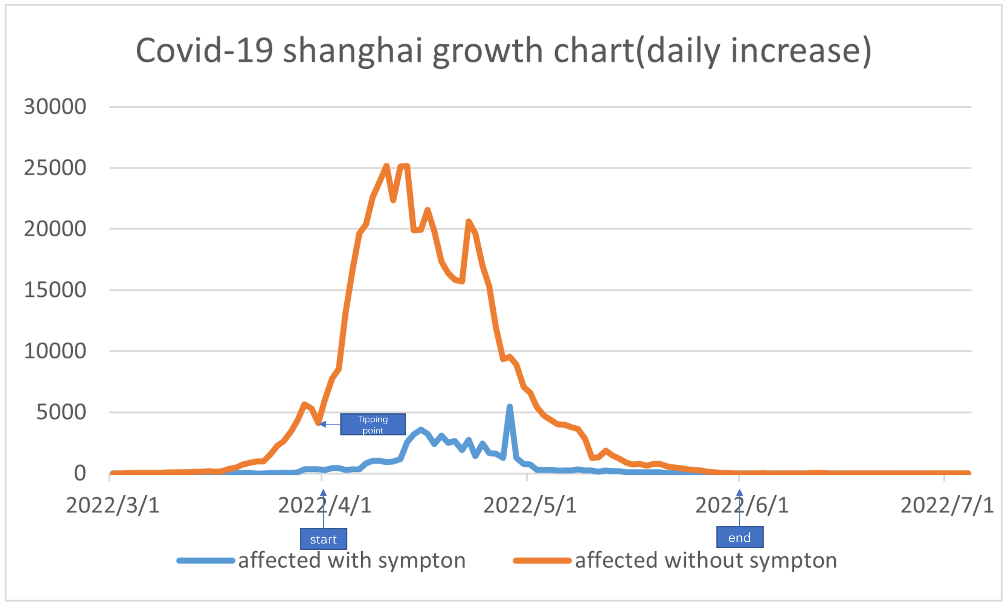
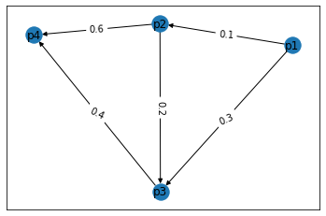
Data & Network Construction
Data collection
  Time chart for covid-19 increase in
  Shanghai【1】
  Overall people in shanghai【2】
  Infection rate of covid-19【3】
Network Construction
  Each node represent a human being living in Shanghai
  A link between two nodes indicates there is a possibility
  of infection from one to the other
  The weight of the link represent the possibility of the
  infection in one day which range from (0,1)
Fig. An example of out network construction
Notes:
Reference:
【1】 http://sh.bendibao.com/news/2020119/233243.shtm
【2】https://www.cdxinghe.com/176097.html
【3】Silverman, Justin D., Nathaniel Hupert, and Alex D. Washburne. "Using influenza surveillance networks to estimate state-specific prevalence of SARS-CoV-2 in the United States." Science translational medicine 12.554 (2020): eabc1126.

Slide 4
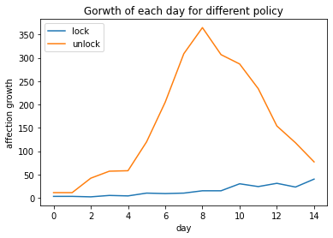
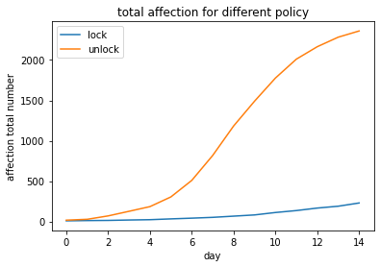
Simulation & Results
Analysis of the lockdown policy
  People will have less time to affect others
  The infection rate would decline
Network modeling detail
  Erdős–Rényi model for simplicity
  We do see network has a small world phenomenon as well as the nearly full connectivity
  Didn’t qualify the power law
Results
  The lockdown policy has decreased 90% of infection in 15 days
  We found that lower the exposure time of the affected people is much more useful than lower the infection rate.
  .
Tipping point
90% reduce
Notes:
Code availability: https://github.com/Kunlun-Zhu/MIT-SocialNetwork-Analyzing/code

Slide 5
A network decision making model
Network
Modeling
K-means
Clustering for
Danger zone
Centrality
For high risk
people
Quarantine
High risk people
Networking
  We shall modeling the covid-19 network with real world data
Clustering
  Using K-means algorithms we could divided the network into k clusters, and classified them into ‘danger zone’ or ‘safer zone’ according to their affection ratio.
Centrality
  We then calculate each node’s centrality to find out those who are in high risk of been affected or will affect others.
Quarantine
  Finally we take action mainly in danger zones and with those who are ‘high-risk’ people.

Slide 6
Conclusion & Future plan
Benefits & drawbacks
  The lockdown policy seems to be very effective according to our simulation.
  To keep it that way, the policy should be a consistent and long-lasting one
  People seem to be more anxious and depressing as the time of quarantine increase【1】
Comparation
  The policy in MIT for example. MIT allow part of the student on campus, keep them in distance without shutdown the whole campus as well as control the affection was keep in a low rate. There’s something we can learn from this.
  The Western policy tends to affect people daily life as little as possible.
Future plans
  To figure out how much economic damage it would cause, and how it affect the world wide supply chain both in short term and in long term.
  Design a more effective policy which will also less demolishing the resident happiness and meet more satisfaction to the policy.
Notes:
Reference:[1] Renaud-Charest, Olivier, et al. "Onset and frequency of depression in post-COVID-19 syndrome: A systematic review." Journal of psychiatric research 144 (2021): 129-137.

Slide 7
Thanks !
Presenter: Kunlun Zhu
Advisor: Prof.Munther Dahleh
TexPoint fonts used in EMF.
Read the TexPoint manual before you delete this box.: AAAAAAAAAAAA

